Slide 1
OPERATOR OVERLOADING

Slide 2
Overloading in C++
What is overloading?
– Overloading means assigning multiple meanings to a function name or operator symbol
– It allows multiple definitions of a function with the same name, but different signatures.
C++ supports
– Function overloading
– Operator overloading

Slide 3
Why is Overloading Useful?
Function overloading allows functions that conceptually perform the same task on objects of different types to be given the same name.
Operator overloading provides a convenient notation for manipulating user-defined objects with conventional operators.

Slide 4
Operator Overloading
Operator overloading
Enabling C++’s operators to work with class objects
Using traditional operators with user-defined objects
Requires great care; when overloading is misused, program difficult to understand

Slide 5
Operator Overloading
Examples of already overloaded operators
Operator << is both the stream-insertion operator and the bitwise left-shift operator
+ and -, perform arithmetic on multiple types
Compiler generates the appropriate code based on the manner in which the operator is used

Slide 6
General Rules for Operator Overloading
Overloading an operator - Write function definition as normal
Syntax:
returnType classname::operator op(arguments)
{
Function body;
} Function name is keyword operator followed by the symbol for the operator being overloaded

Slide 7
General Rules for Operator Overloading
Using operators
To use an operator on a class object it must be overloaded unless the assignment operator(=)or the address operator(&)
Assignment operator by default performs memberwise assignment
Address operator (&) by default returns the address of an object

Slide 8
Steps
1. Create a class that is to be used
2.Declare the operator function in the public part of the class. It may be either member function or friend function.
3.Define operator function to implement the operation required
4.Overloaded can be invoked using the syntax such as: op x;

Slide 9
Restrictions on Operator Overloading
Following C++ Operator can’t be overloaded
Class member access operators(. & .*)
Scope Resolution Operator(::)
Sizeof Operator(sizeof())
Conditional Operator(? :)

Slide 10
Restrictions on Operator Overloading
Overloading restrictions
Precedence ,associativity, arity (number of operands) of an operator cannot be changed
No new operators can be created
Use only existing operators
No overloading operators for built-in types
Cannot change how two integers are added

Slide 11
Operator Functions as Class Members vs. as friend Functions
In general, operator functions can be member or non-member functions
Operator functions as member functions
Leftmost operand must be an object (or reference to an object) of the class
Operator functions as non-member friend functions
Must be friends if needs to access private or protected members

Slide 12
Overloadable Operators
+ | - | * | / | % | ^
& | | | ~ | ! | , | =
< | > | <= | >= | ++ | --
<< | >> | == | != | && | ||
+= | -= | /= | %= | ^= | &=
|= | *= | <<= | >>= | [] | ()
-> | ->* | new | new [] | delete | delete []
Non-overloadable Operators
:: | .* | . | ?:

Slide 13
Operator Overloading can be done by using three approaches, they are
Overloading unary operator.
Overloading binary operator.
Overloading binary operator using a friend function.

Slide 14
Function Overloading
Is the process of using the same name for two or more functions
Requires each redefinition of a function to use a different function signature that is:
different types of parameters,
or sequence of parameters,
or number of parameters
Is used so that a programmer does not have to remember multiple function names

Slide 15
Function Overloading
Two or more functions can have the same name but different parameters
Example:
int max(int a, int b)
{
if (a>= b)
return a;
else
return b;
}
float max(float a, float b)
{
if (a>= b)
return a;
else
return b;
}

Slide 16
Overloading Function Call Resolution
Overloaded function call resolution is done by compiler during compilation
– The function signature determines which definition is used
a Function signature consists of:
– Parameter types and number of parameters supplied to a function
a Function return type is not part of function signature and is not used in function call resolution

Slide 17
Function overloading example:
void sum(int,int);
void sum(double,double);
void sum(char,char);
void main()
{
int a=10,b=20 ;
double c=7.52,d=8.14;
char e=‘a’ , f=‘b’ ;
sum(a,b);
//calls sum(int x,int y)
sum(c,d);
alls sum (double x,double y)
sum(e,f);
// calls sum(char x,char y)
}
void sum(int x,int y)
{
vout<<“\n sum of integers are”<<x+y;
}
void sum(double x,double y)
{
cout<<“\n sum of two floating no are”<<x+y;
}
void sum(char x,char y)
{
cout<<“\n sum of characters are”<<x+y;
}
Output:
Sum of integers 30
sum of two floating no are 15.66
sum of characters are 195
Notes:
Multiple function with same name and same number of parameters differ only in data types

Slide 18
Function overloading example:
#include<iostream>
Using namespace std;
void area(int x)
{ cout<<“area is”<<x*x;
}
void area(int x,int y)
{cout<<“area of rectang;e”=<<x*y;
}
void area(int x,int y,int z)
{cout<<“volume is”<<x*y*z;
}
int main()
{
int side=10,le=5,br=6,a=4,b=5,c=6;
area(side);
area(le,br);
area(a,b,c);
return 0;
}

Slide 19
Function Selection Involves following Steps.
Compiler first tries to find the Exact match in which the type of argument are the same,and uses that func.
If an exact match is not found,the compiler user the integral promotions to the actual argument such as,char to int, float to double.
When either of them fails ,build in conversions are used(implicit conversion) to the actual arguments and then uses the function whose match is unique. But if there are multiple matches, then compiler will generate an error message.

Slide 20
For ex: long square(long n)
long square(double x)
Now a func. call such as square(10) will cause an error because int argument can be converted into long also and double also.so it will show ambiguity.
User defined conversion are followed if all the conversion are failed.

Slide 21
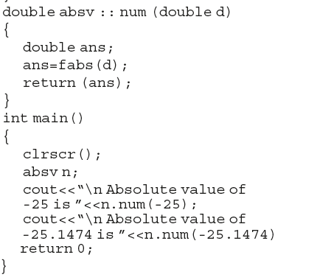
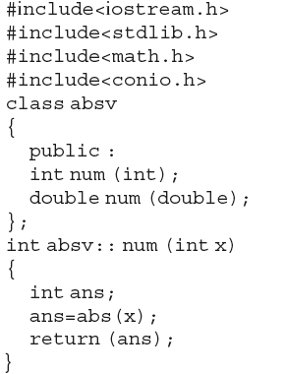
Overload Member function
Takes sample property as member function.
Note : Need to be explained with all function overloading concept.

Slide 22
Overloading the assignment operator
The assignment operator (operator=) is used to copy values from one object to another already existing object.
Assignment vs Copy constructor
The purpose of the copy constructor and the assignment operator are almost equivalent -- both copy one object to another. However, the copy constructor initializes new objects, whereas the assignment operator replaces the contents of existing objects.
The difference between the copy constructor and the assignment operator causes a lot of confusion for new programmers, but it’s really not all that difficult. Summarizing:
If a new object has to be created before the copying can occur, the copy constructor is used (note: this includes passing or returning objects by value).
If a new object does not have to be created before the copying can occur, the assignment operator is used.

Slide 23
#include <iostream>
using namespace std;
class Distance
{
private: int feet; // 0 to infinite
int inches; // 0 to 12
public: // required constructors
Distance()
{
feet = 0; inches = 0;
}
Distance(int f, int i)
{ feet = f; inches = i; }
void operator = (const Distance &D )
{ feet = D.feet; inches = D.inches; }
// method to display distance
void displayDistance()
{ cout << "F: " << feet << " I:“ << inches << endl;
} };
int main()
{ Distance D1(11, 10), D2(5, 11);
cout << "First Distance : "; D1.displayDistance();
cout << "Second Distance :"; D2.displayDistance();
// use assignment operator
D1 = D2; cout << "First Distance :";
D1.displayDistance(); return 0; }
Output:
First Distance : F: 11 I:10
Second Distance :F: 5 I:11
First Distance :F: 5 I:11

